Slide 1

NYC Yellow Taxi Data Analysis
‘The City That Never Sleeps’

Slide 2
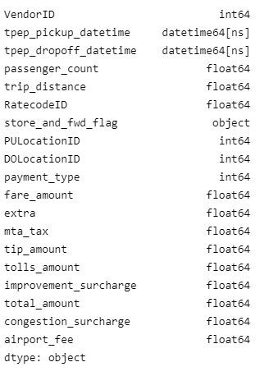

ABOUT THE DATASET
Data is taken from the official NYC Taxi and Limousine Commission site.
This dataset consists of fields capturing pick-up and drop-off dates/times, pick-up and drop-off locations, trip distances, itemized fares, rate types, payment types, and driver-reported passenger counts.
Predict the fare price of the next trip?

Slide 3

It’s all about data cleaning and pre-processing!

Slide 4
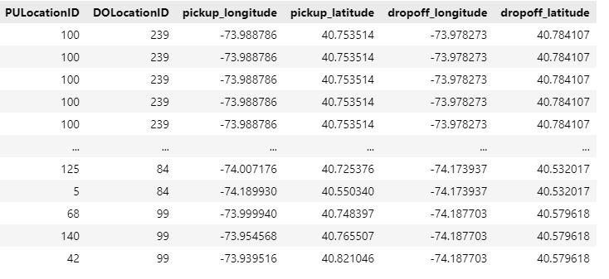
Step 1: Remove all null values
Step 2: Drop columns that are not required like store_and_fwd_flag, payment_type
Step 3: Now, we will map our PULocationID to pickup_longitude and pickup_latitude and we will map DOLocationID to dropoff_longitude and dropoff_latitude

Slide 5
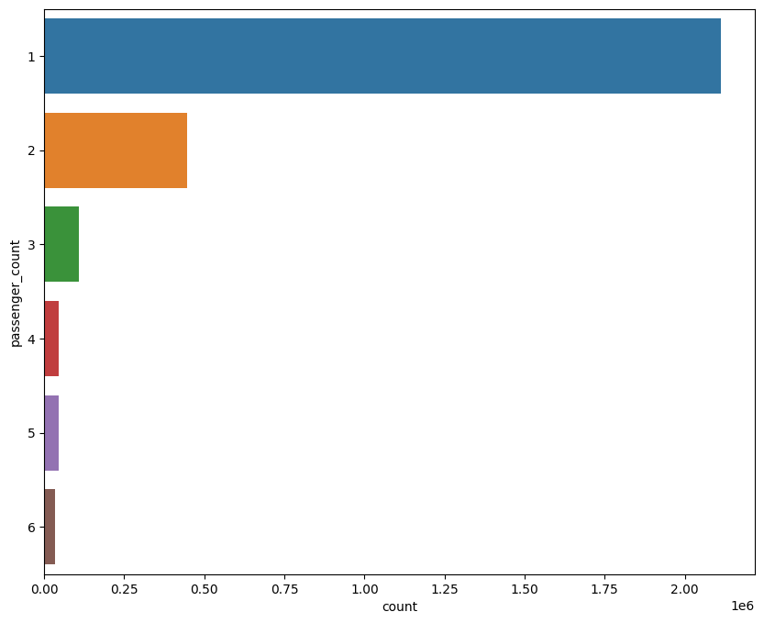
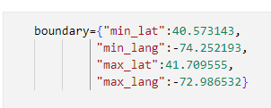
Step 4: We will now remove data where the latitude and longitude of Pickup / Dropoff locations are invalid.
Step 5: Remove where pickup and drop location are same!
Step 6: Setting boundary for new york latitude longitude and removing rows where pickup/drop is out of this boundary.
Step 7: Fare amount can not be negative so remove this data.
Step 8: Cleaning the data with respect to passenger count

Slide 6
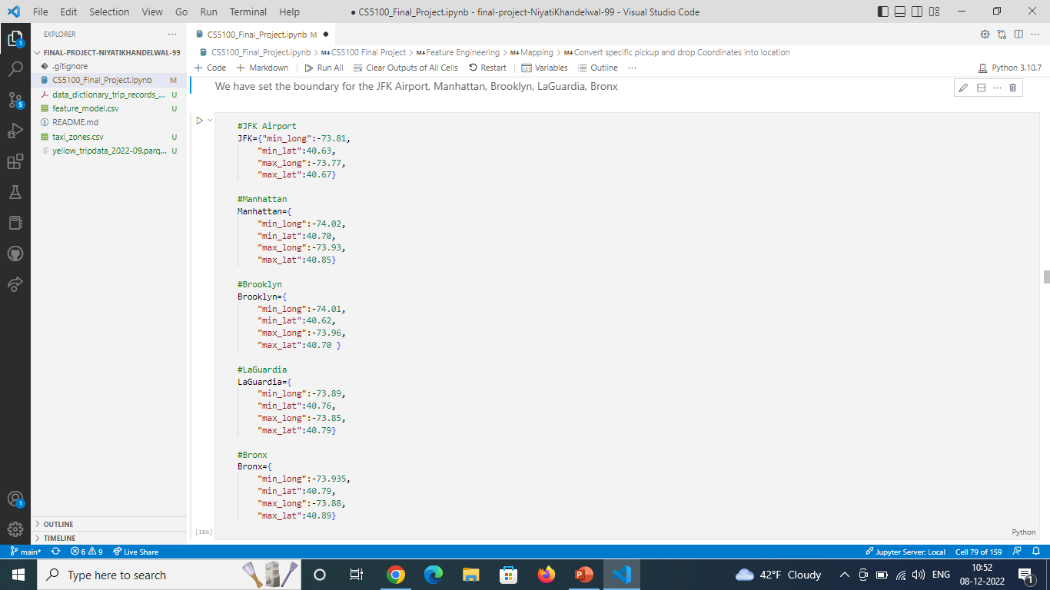
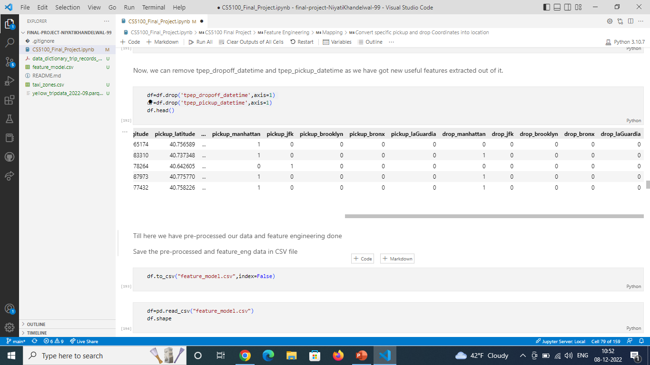
FEATURE ENGINEERING
Extract day, weekday, pick up hour from pickup_datetime
Mid-night trip (11 o’clock to morning 5 AM)
Rush hour trip (NYC rush hour timings from 4PM – 9PM)
Trip Distance
Convert specific pickup and drop Coordinates into location

Slide 7
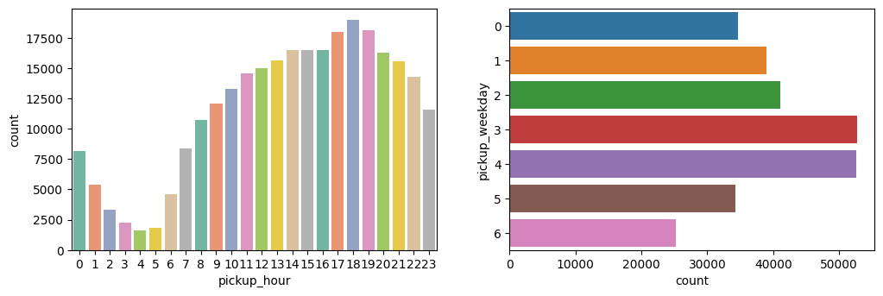
Some visualizations during this process

Slide 8
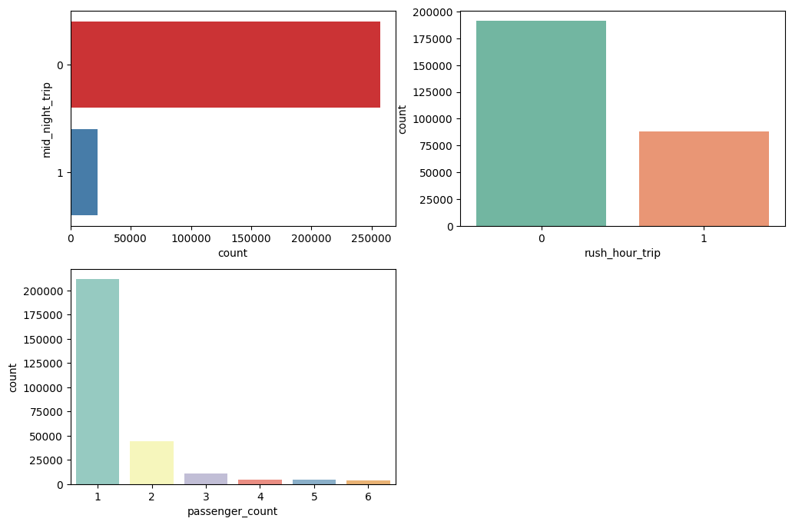

Slide 9
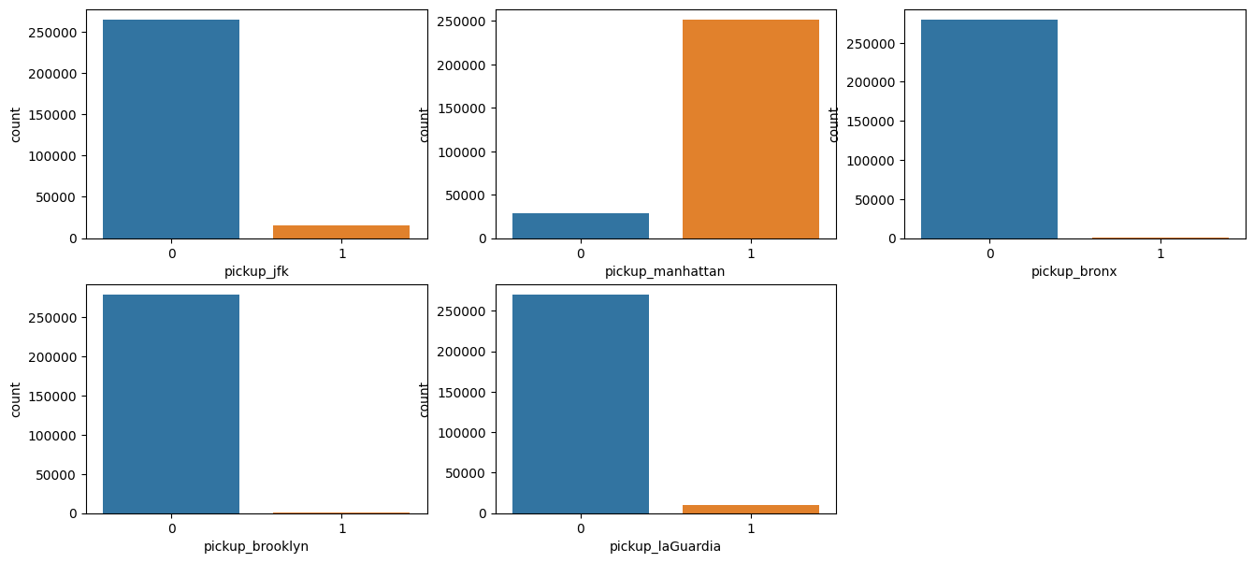

Slide 10
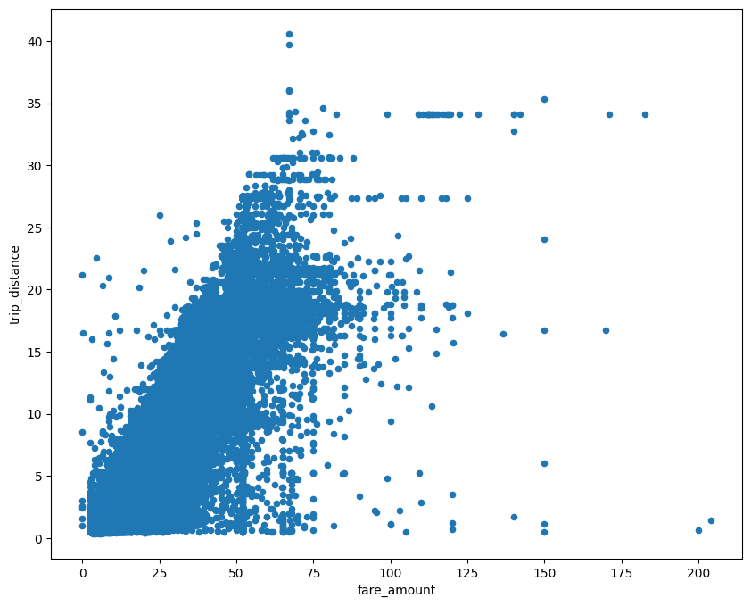
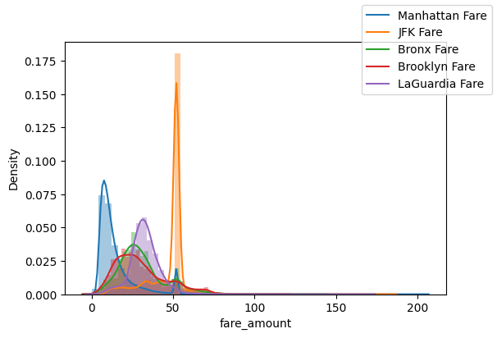

Slide 11
Learning Models
1. Linear Regression Model
2. Decision Tree Regressor Model
3. Random Forest Regressor Model
4. AdaBoost Regressor Model
5. XGB Regressor Model

Slide 12
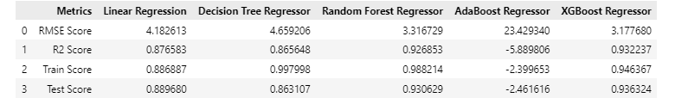
Comparison of the performance of the 5 models
As we can observe, XGBoost Regressor performs the best out of all the 5 models

Slide 13
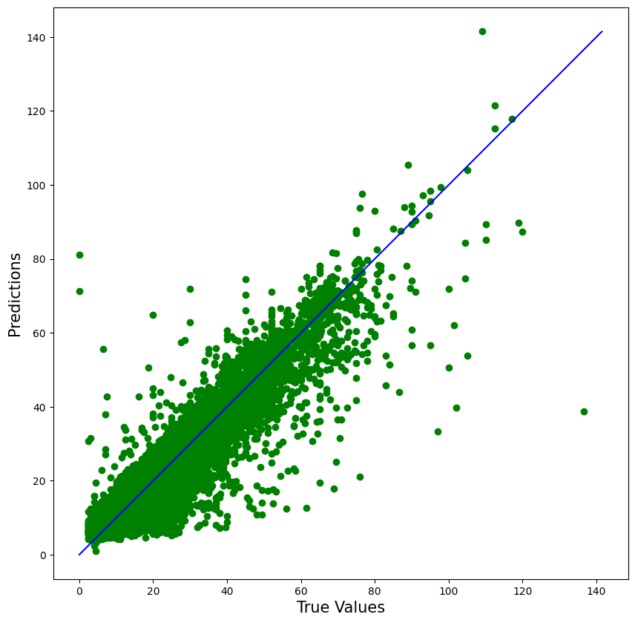

Slide 14
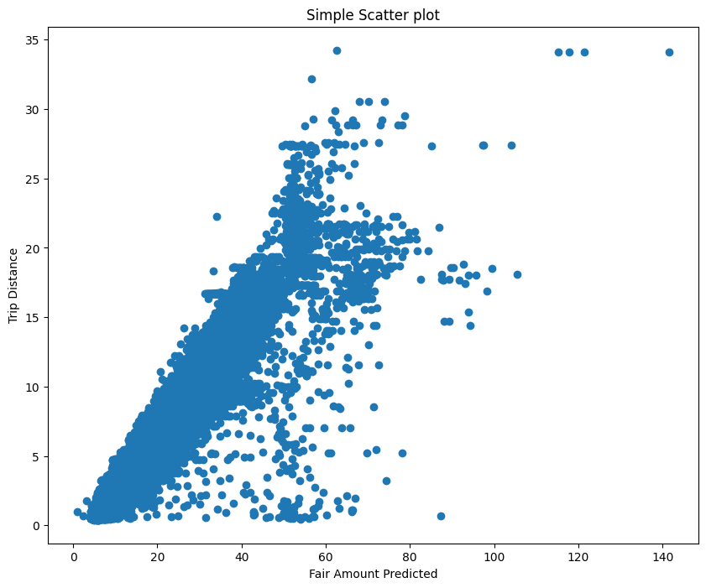

Slide 15
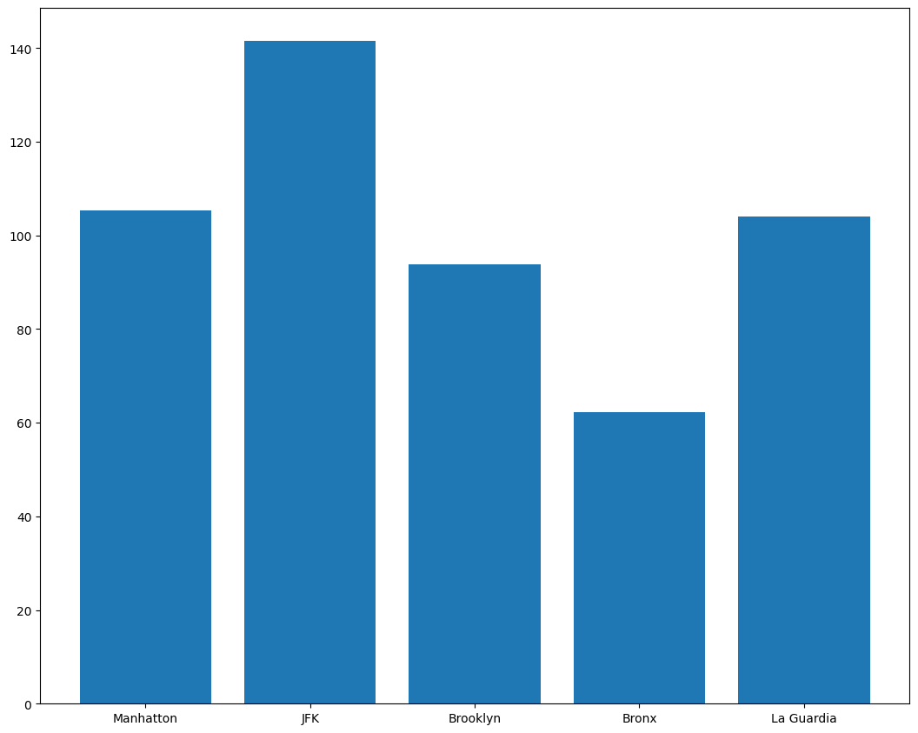
Which pick up area had the highest fare rate for a taxi trip?

Slide 16
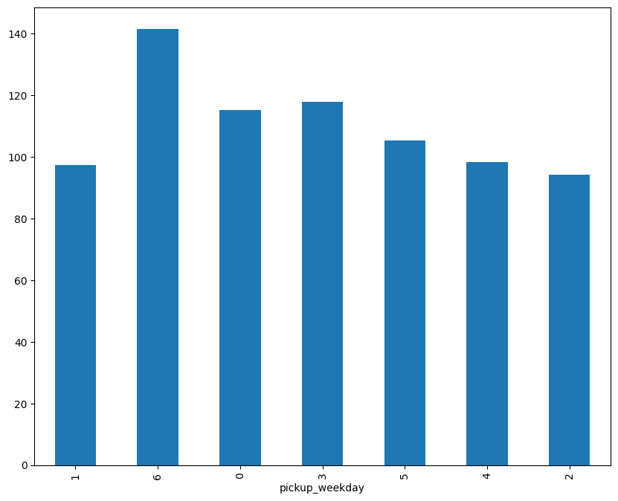
Which weekday had the highest fare rate for a trip?

Slide 17

THANK YOU!

